Slide 1
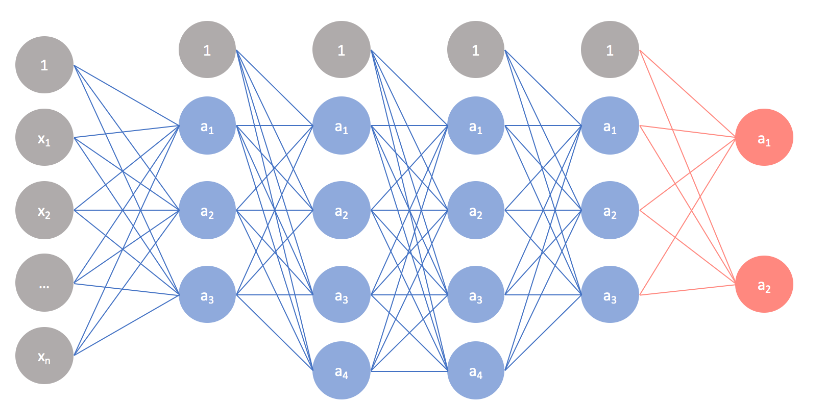
NN basics

Slide 2
References
http://cs231n.stanford.edu/index.html
http://www.cs.cornell.edu/courses/cs5670/2019sp/lectures/lectures.html
http://www.cs.cmu.edu/~16385/

Slide 3
contents
The classification problem- again
NN history
Perceptron
Hyperplanes
Activation
Dense layer
Multi-layer perceptron (MLP)
Optimization
Softmax + cross entropy + loss
Gradient descent
Basic data preprocessing
Data normalization
Train, validation and test splits

Slide 4
contents
The classification problem- again
NN history
Perceptron
Hyperplanes
Activation
Dense layer
Multi-layer perceptron (MLP)
Optimization
Softmax + cross entropy + loss
Gradient descent
Basic data preprocessing
Data normalization
Train, validation and test splits

Slide 5
What will we know to do?
Hopefully by the end of the course:
https://teachablemachine.withgoogle.com/

Slide 6
What is a neural network
Artificial neural networks (ANN / NN) are computing systems vaguely inspired by the biological neural networks that constitute animal brains. Such systems "learn" to perform tasks by considering examples, generally without being programmed with task-specific rules.
[Wikipedia]

Slide 7
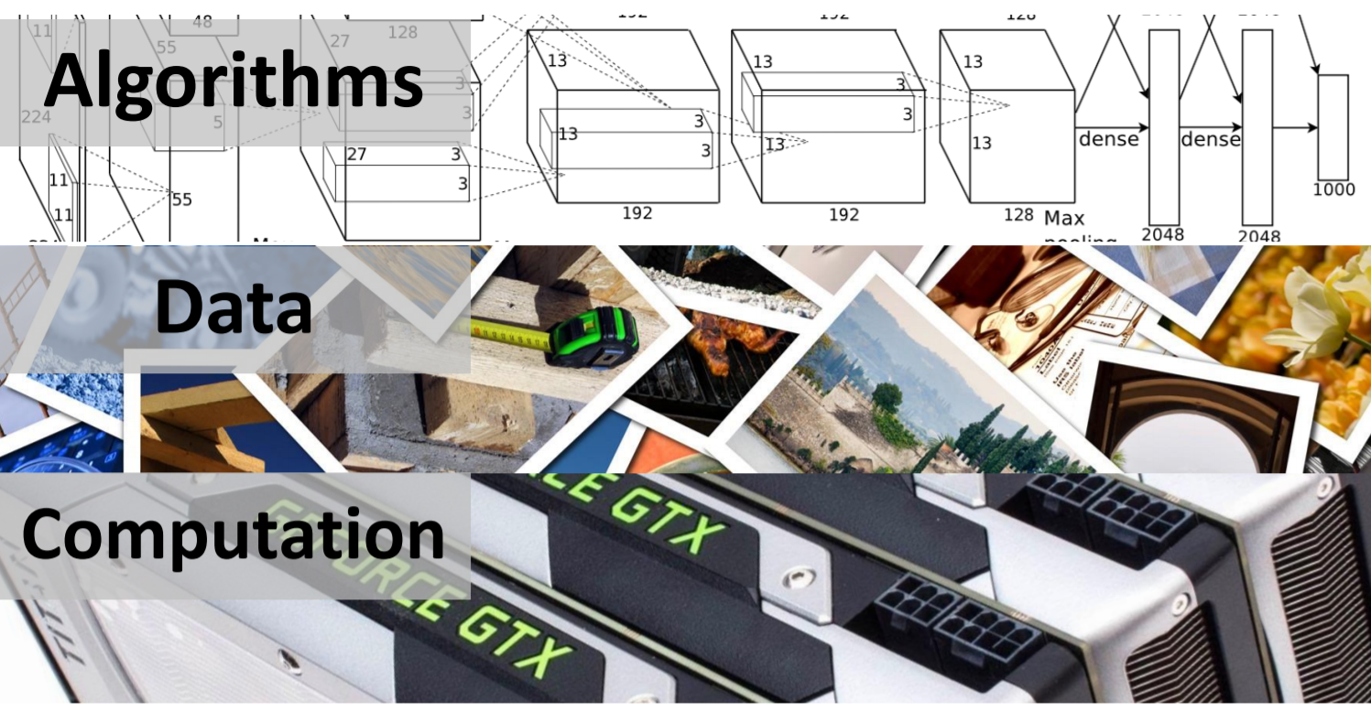
What does a NN needs?

Slide 8
What a neural network can do?
Image based:
Object recognition
Human pose detection
3D reconstruction from a signal image
Image captioning
Style transfer
Non image based:
Language translation
Game playing
And much-much more…

Slide 9
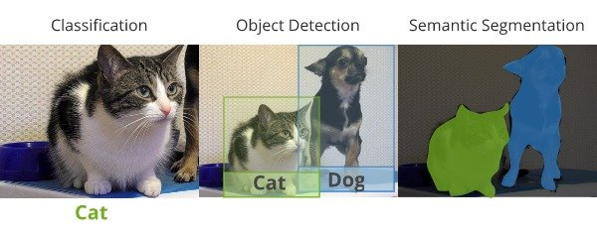
Object recognition

Slide 10

Object recognition

Slide 11
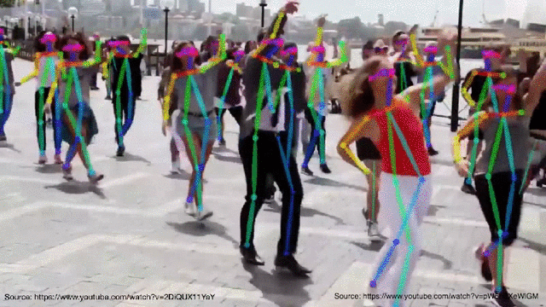
Human pose detection

Slide 12
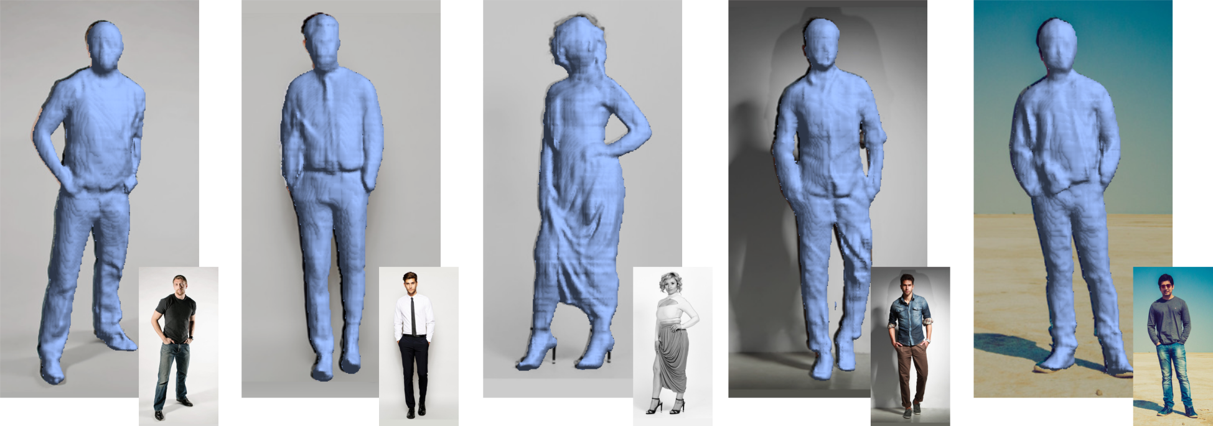
3D reconstruction from a single image

Slide 13
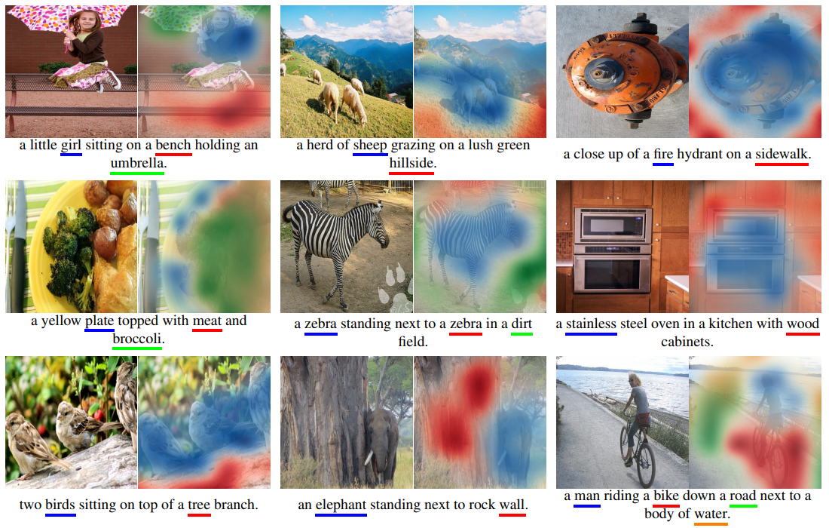
Image captioning

Slide 14
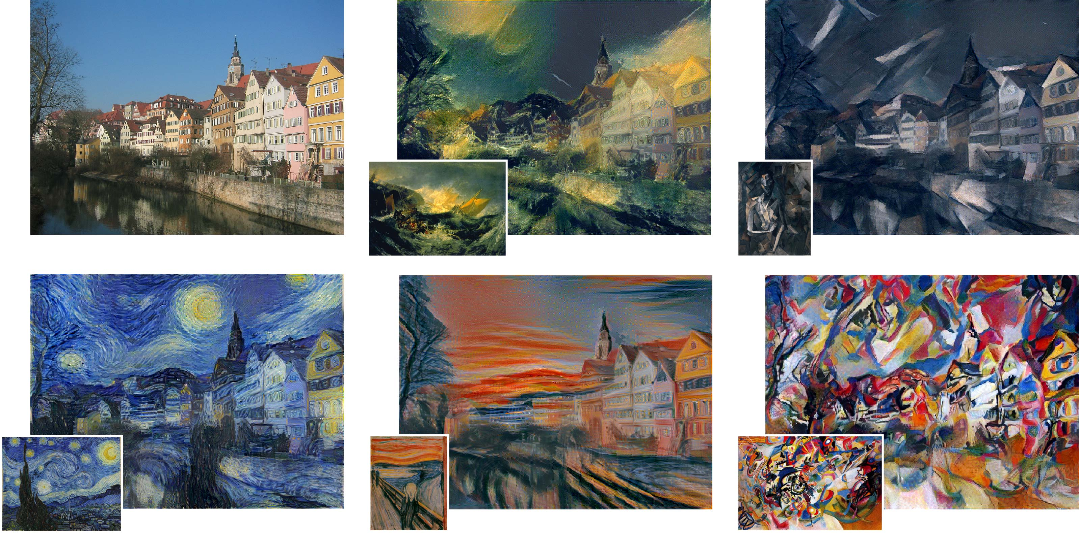
Style transfer

Slide 15
Object recognition challenges
As we’ve seen before- object recognition is hard!

Slide 16
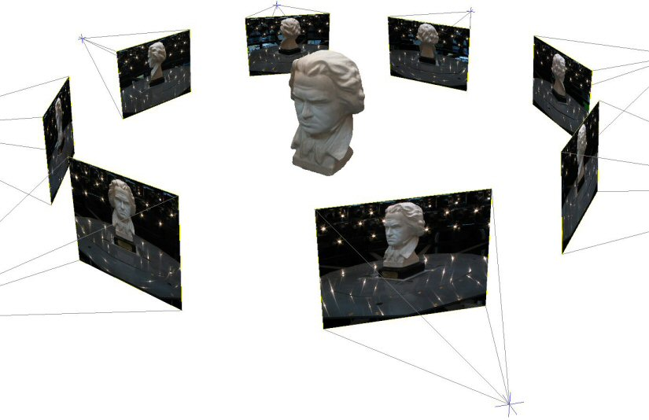
Challenge: variable viewpoint

Slide 17
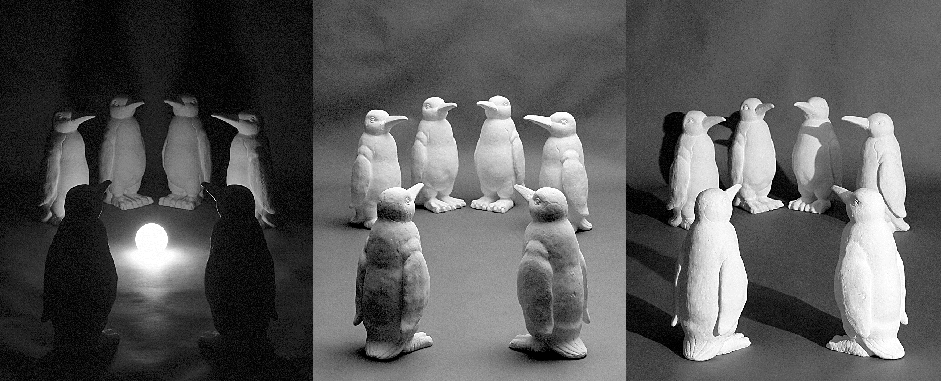
Challenge: variable illumination
image credit: J. Koenderink

Slide 18
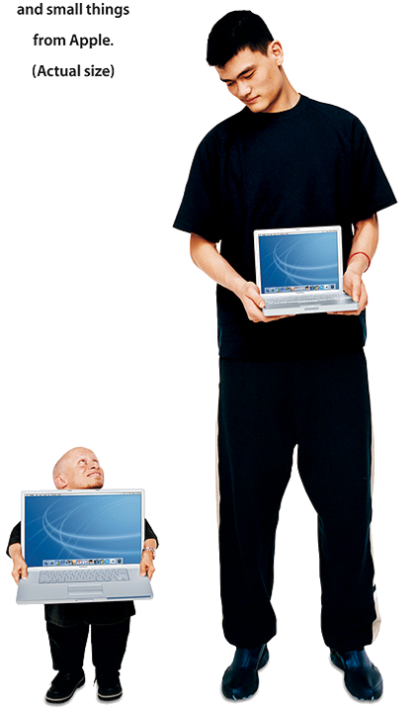
Challenge: scale

Slide 19
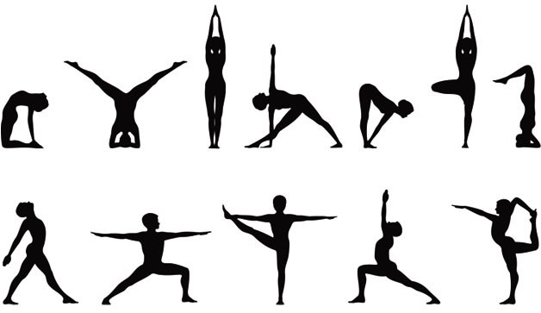
Challenge: deformation

Slide 20
Challenge: occlusion

Slide 21
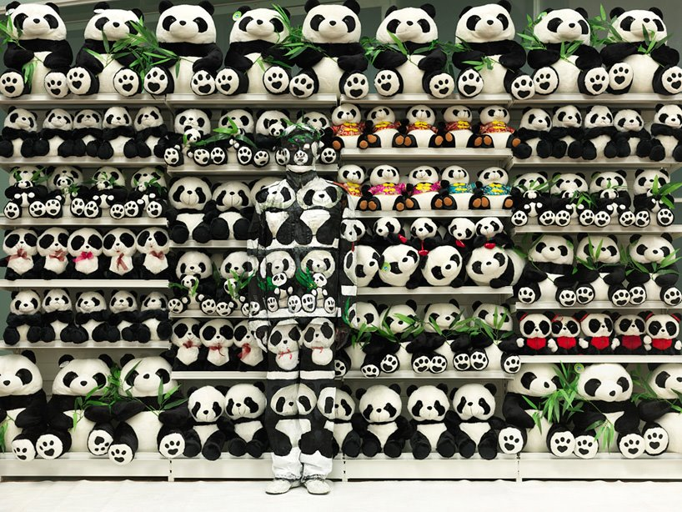
Challenge: background clutter

Slide 22
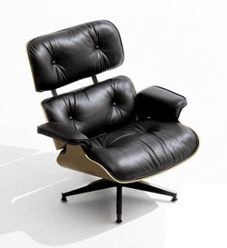
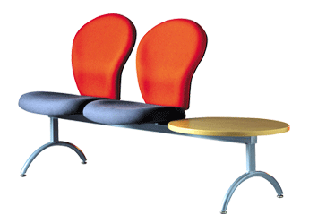
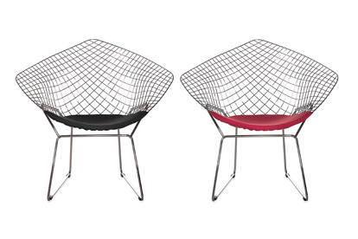
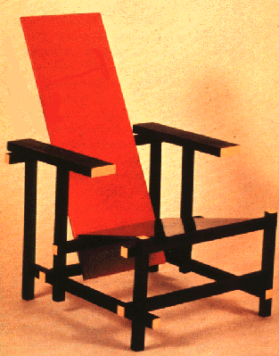
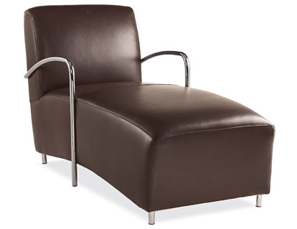
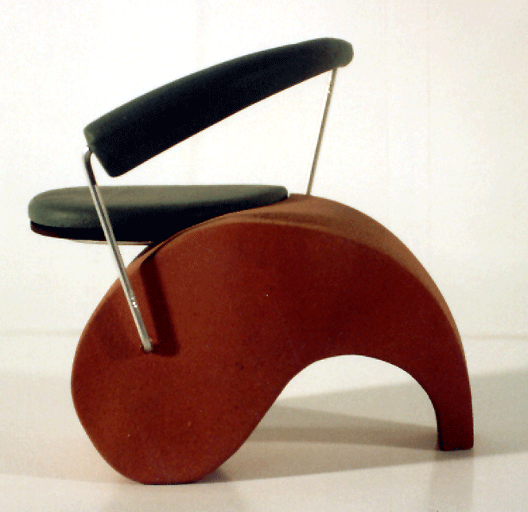
Challenge: intra-class variations
Svetlana Lazebnik

Slide 23
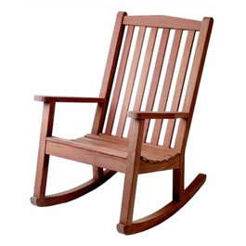
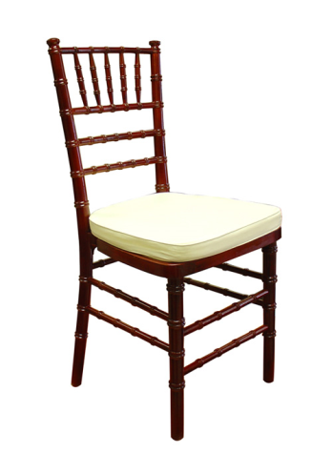
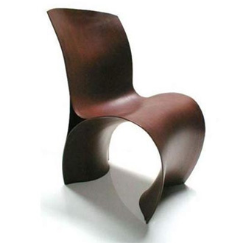
Object recognition challenges
We’ve already seen that this is a hard problem to tackle with “classic” CV algorithms like SIFT and template matching.
Template matching does a relatively good job to find the same template instance in an image.
SIFT can extend this to find the instance with changing viewpoint/scale/illumination and rotation.
What happens when want to find similar object that are not the same?
NN for the win!

Slide 24
contents
The classification problem- again
NN history
Perceptron
Hyperplanes
Activation
Dense layer
Multi-layer perceptron (MLP)
Optimization
Softmax + cross entropy + loss
Gradient descent
Basic data preprocessing
Data normalization
Train, validation and test splits

Slide 25
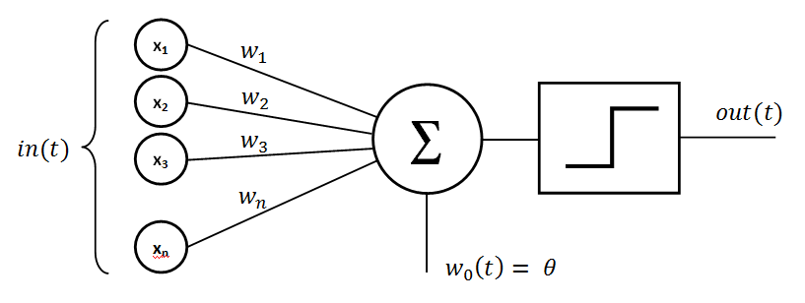
perceptron
The basic building block of all NN.
First introduced in 1958 at Cornell Aeronautical Laboratory by Frank Rosenblatt.
We will talk more about it in a moment…

Slide 26

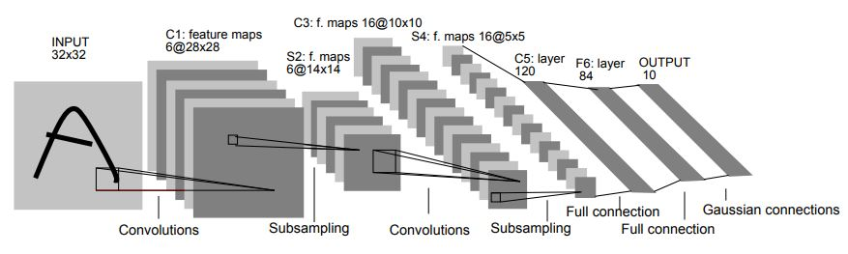
MNIST + LeNet-5
MNIST is a large dataset of handwritten digits used in training of LeNet-5.
LeNet-5 is the first known NN to solve a major computer vision problem:
Classifies digits, was applied by several banks to recognize hand-written numbers on checks.
Used 7 trainable layers with a total of 60K params (sounds a lot?).
Yann LeCun at el., 1998, 23000 citations.

Slide 27
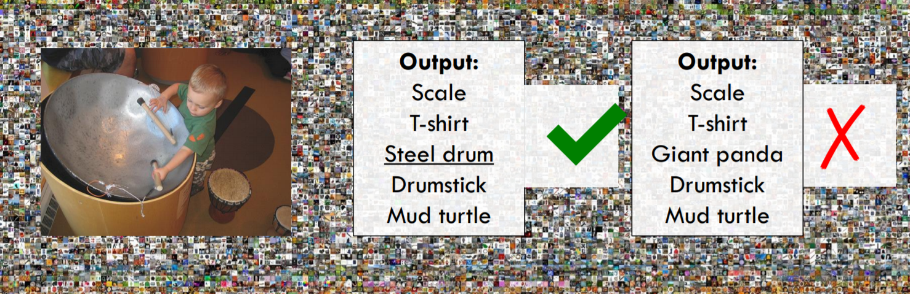
Large Scale Visual Recognition Challenge (ILSVRC)
ImageNet is an image database most known for its ILSVRC challenge, and specifically for the image classification contest:
1000 object classes
1,431,167 images
Winner has the minimum mean labeling error out of 5 gausses for a given unknown test set.

Slide 28
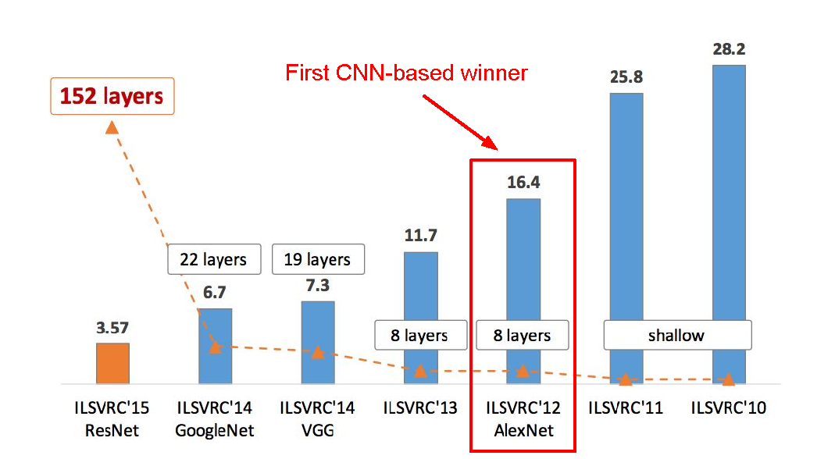
ILSVRC winners
Human error: 5%

Slide 29
contents
The classification problem- again
NN history
Perceptron
Hyperplanes
Activation
Dense layer
Multi-layer perceptron (MLP)
Optimization
Softmax + cross entropy + loss
Gradient descent
Basic data preprocessing
Data normalization
Train, validation and test splits

Slide 30
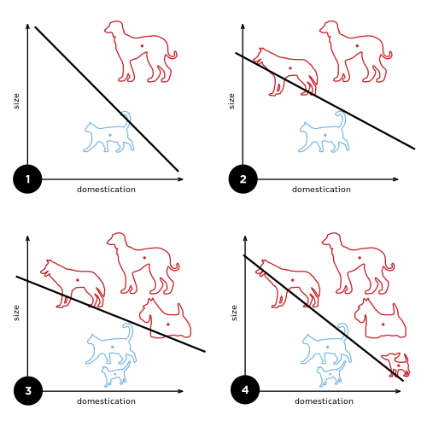
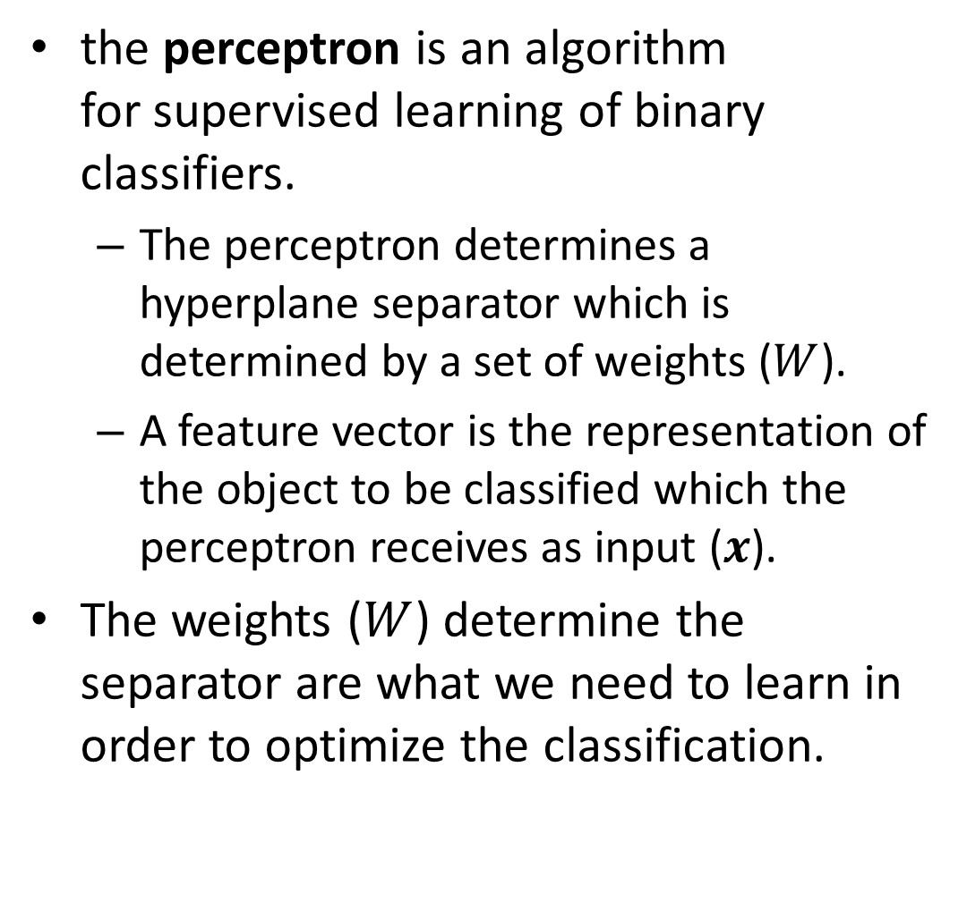
Perceptron
the perceptron is an algorithm for supervised learning of binary classifiers.
The perceptron determines a hyperplane separator which is determined by a set of weights ($W$).
A feature vector is the representation of the object to be classified which the perceptron receives as input ($x$).
The weights ($W$) determine the separator are what we need to learn in order to optimize the classification.

Slide 31
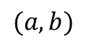
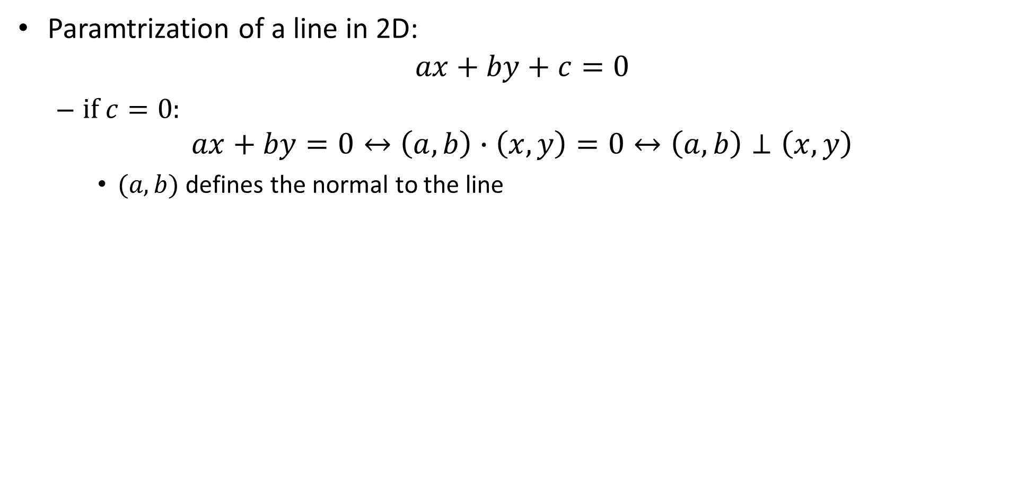
hyperplane
Paramtrization of a line in 2D:
$$ax+by+c=0$$
if $c=0$:
$$ax+by=0↔\left(a,b\right)∙\left(x,y\right)=0↔\left(a,b\right)⊥\left(x,y\right)$$
$(a,b)$ defines the normal to the line
$$(a,b)$$

Slide 32
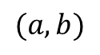
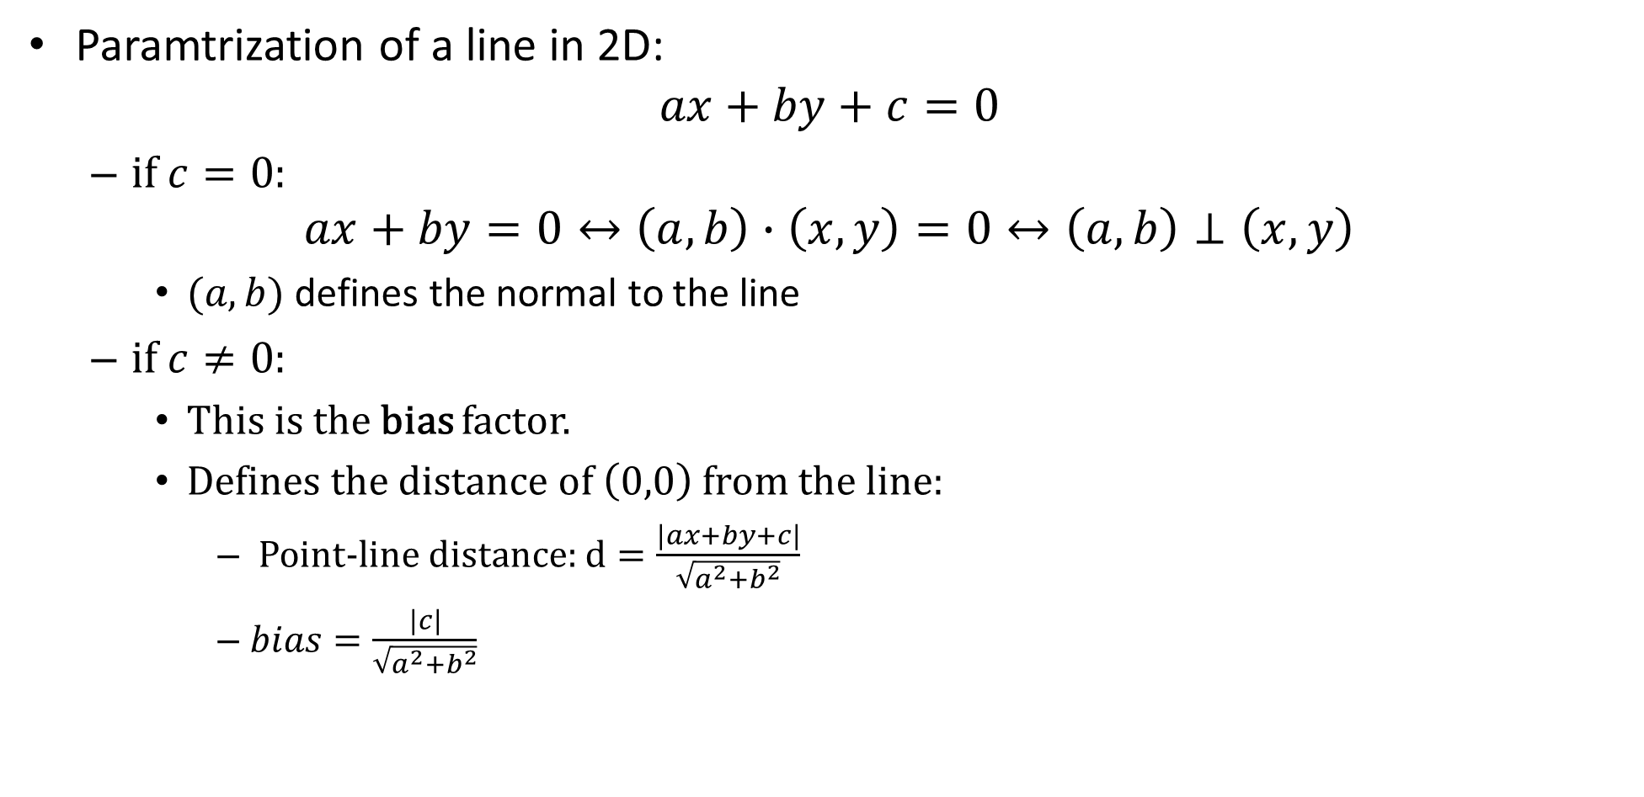
hyperplane
Paramtrization of a line in 2D:
$$ax+by+c=0$$
if $c=0$:
$$ax+by=0↔\left(a,b\right)∙\left(x,y\right)=0↔\left(a,b\right)⊥\left(x,y\right)$$
$(a,b)$ defines the normal to the line
if $c≠0$:
This is the bias factor.
Defines the distance of $\left(0,0\right)$ from the line:
Point-line distance: $d=\frac{\left|ax+by+c\right|}{\sqrt{a^{2}+b^{2}}}$
$bias=\frac{\left|c\right|}{\sqrt{a^{2}+b^{2}}}$
$$(a,b)$$

Slide 33
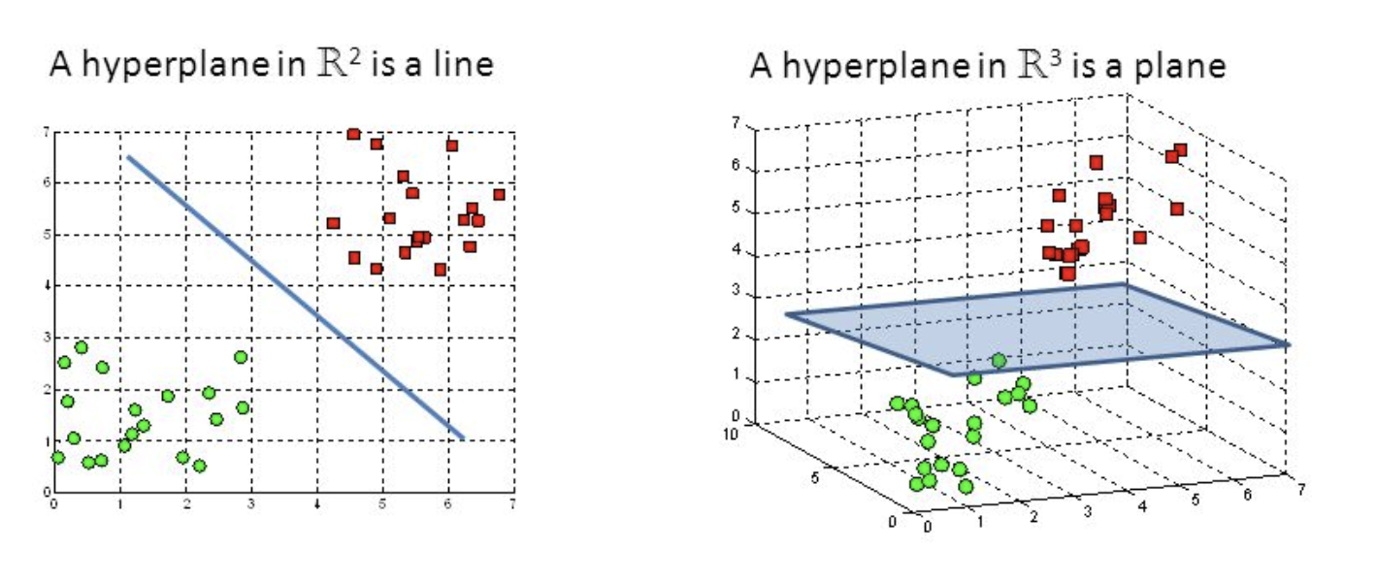
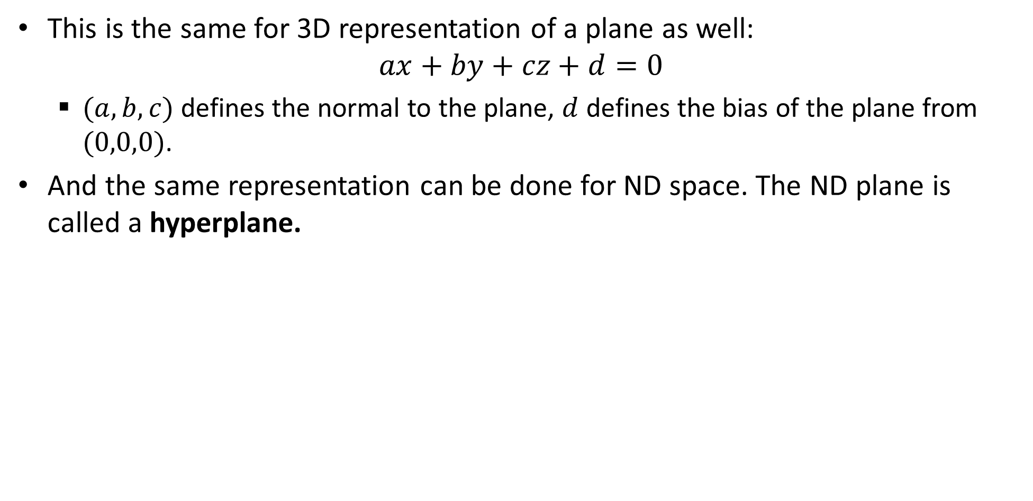
hyperplane
This is the same for 3D representation of a plane as well:
$$ax+by+cz+d=0$$
$(a,b,c)$ defines the normal to the plane, $d$ defines the bias of the plane from $(0,0,0)$.
And the same representation can be done for ND space. The ND plane is called a hyperplane.

Slide 34
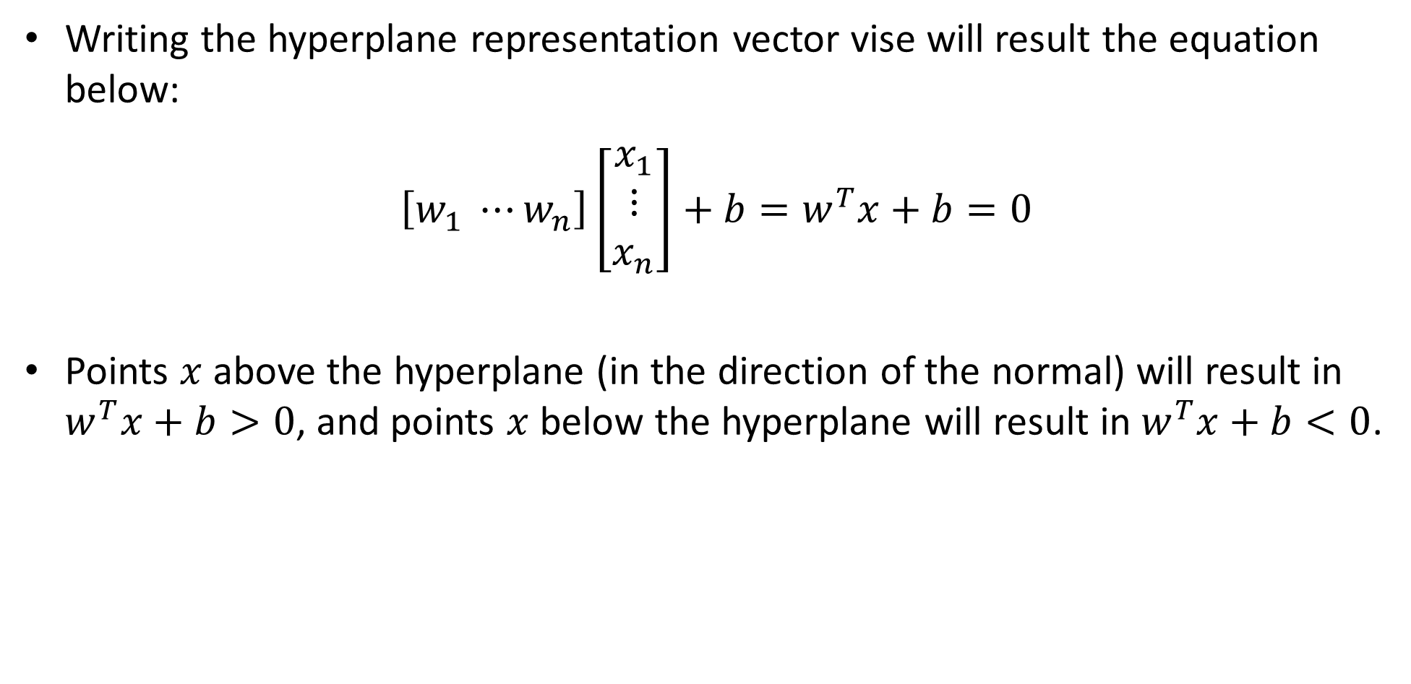
hyperplane
Writing the hyperplane representation vector vise will result the equation below:
$\left[w_{1} ⋯w_{n}\right]\left[\begin{aligned}x_{1} \\ ⋮ \\ x_{n}\end{aligned}\right]+b=w^{T}x+b=0$
Points $x$ above the hyperplane (in the direction of the normal) will result in $w^{T}x+b>0$, and points $x$ below the hyperplane will result in $w^{T}x+b<0$.

Slide 35
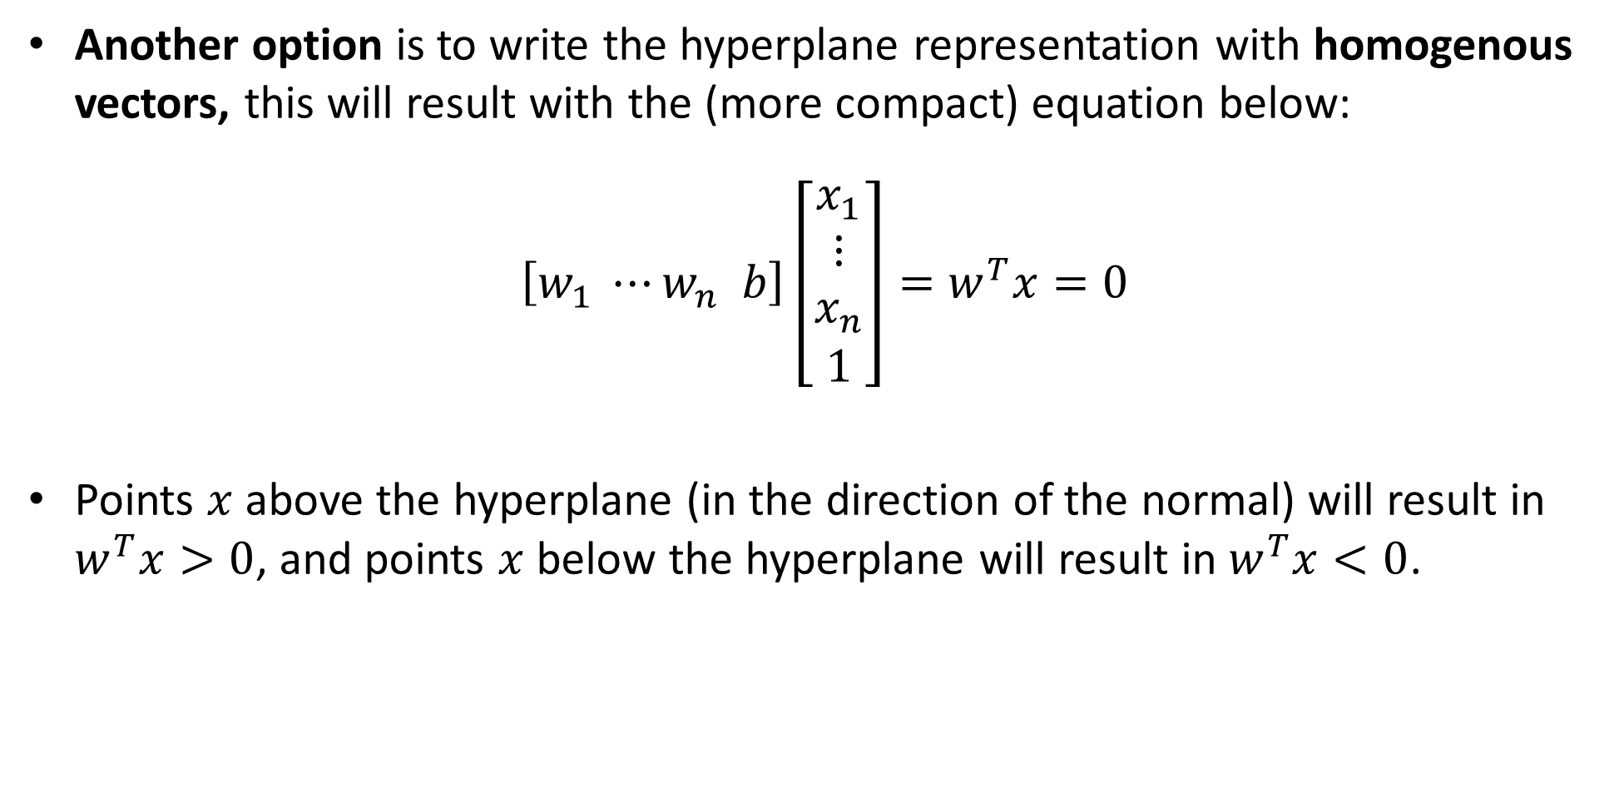
hyperplane
Another option is to write the hyperplane representation with homogenous vectors, this will result with the (more compact) equation below:
$\left[w_{1} ⋯w_{n} b\right]\left[\begin{aligned}x_{1} \\ ⋮ \\ x_{n} \\ 1\end{aligned}\right]=w^{T}x=0$
Points $x$ above the hyperplane (in the direction of the normal) will result in $w^{T}x>0$, and points $x$ below the hyperplane will result in $w^{T}x<0$.

Slide 36
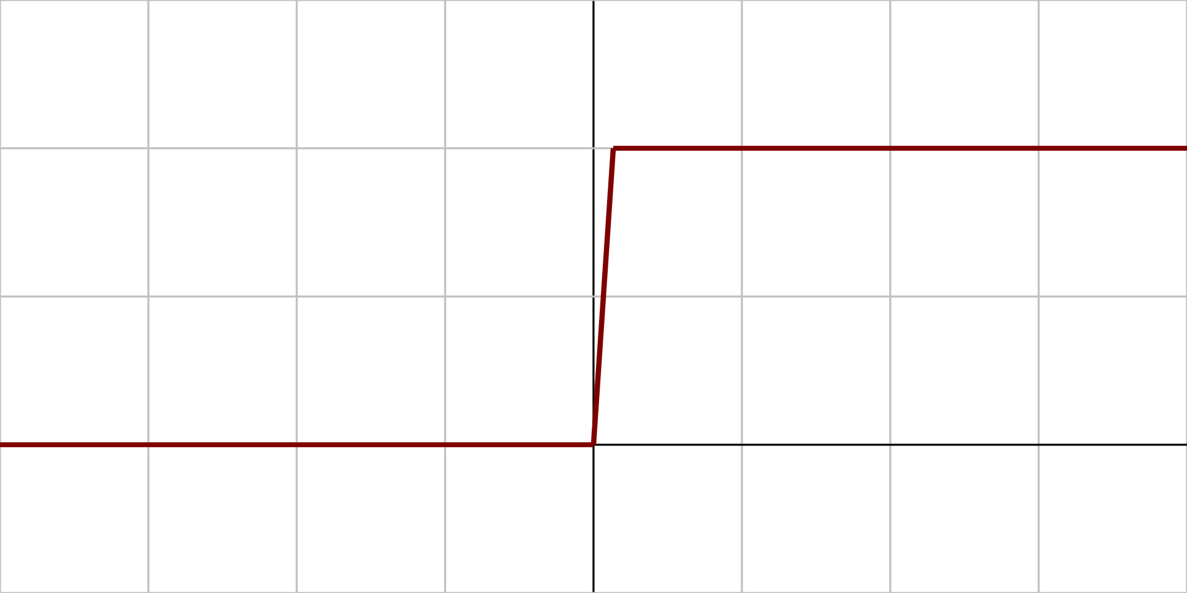
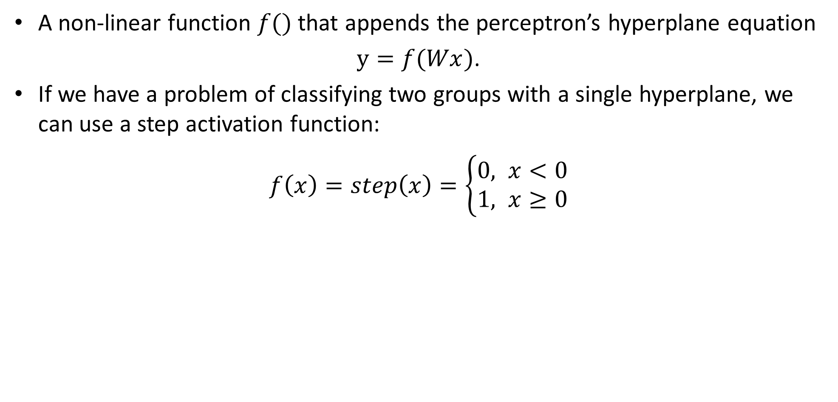
Activation function
A non-linear function $f()$that appends the perceptron’s hyperplane equation
$y=f(Wx)$.
If we have a problem of classifying two groups with a single hyperplane, we can use a step activation function:
$f\left(x\right)=step\left(x\right)=$ $\left\{\begin{aligned}0, x<0 \\ &1, x≥0\end{aligned}\right.$
+1
+1
0
0

Slide 37
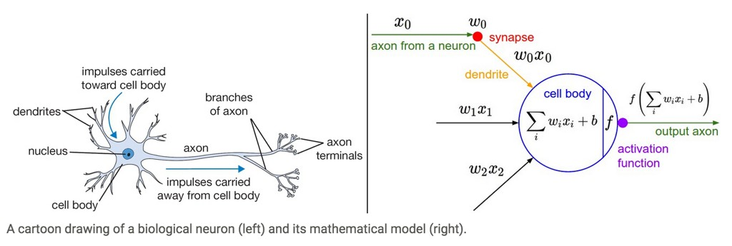
perceptron: Inspiration from Biology
Neural nets/perceptrons are loosely inspired by biology.
But they certainly are not a proper model of how the brain works, or even how neurons work.

Slide 38
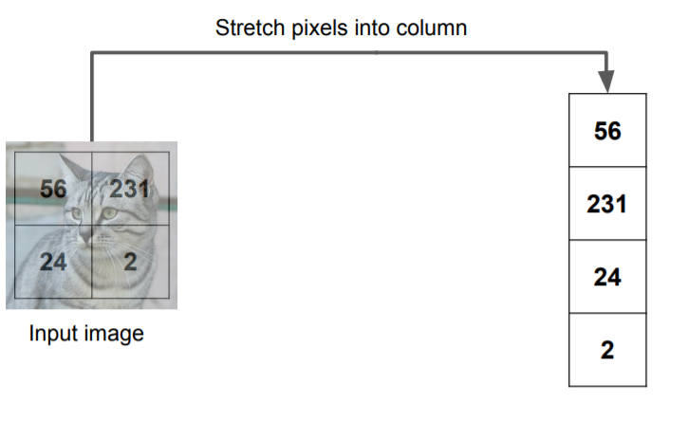
Images as inputs
In images, the pixels can be the input feature vector.

Slide 39
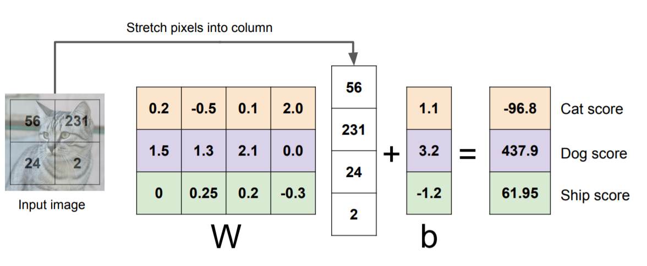
Images as inputs
We want to find a hyperplane in 4D space that puts all cats’ vectors in one side of it, and all other images in the other side.

Slide 40
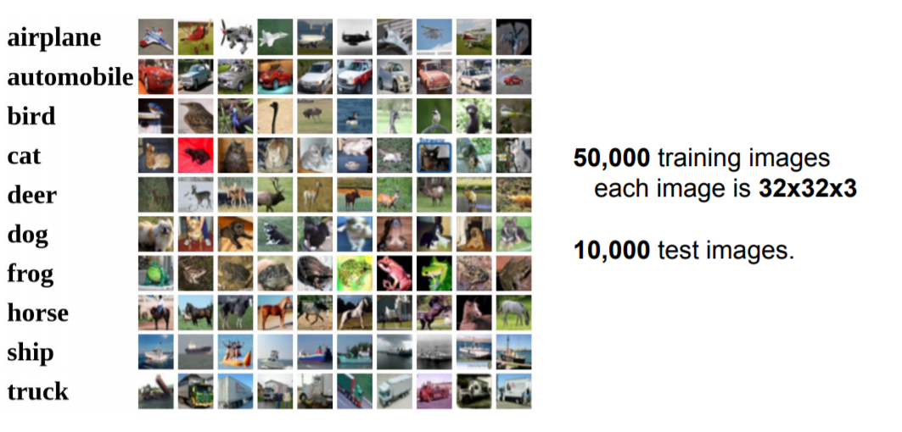
CIFAR10 dataset
CIFAR10 (Canadian Institute For Advanced Research) is a known dataset of 10 classes of small images.
10 classes

Slide 41
CIFAR10 dataset
CIFAR10 (Canadian Institute For Advanced Research) is a known dataset of 10 classes of small images.
32X32X3=3072 DOFs in this problem, and images vary a lot. This is not possible to linearly separate.
10 classes

Slide 42
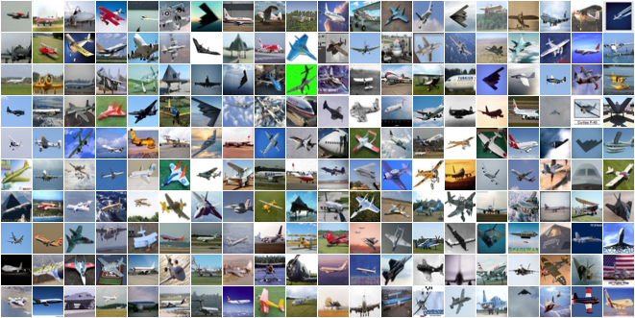
What is the best separator for such data?
Assume the pixels values are [0,255] -> [-127,128]

Slide 43
What is the best separator for such data?
We can try and take the mean image per class.

Slide 44
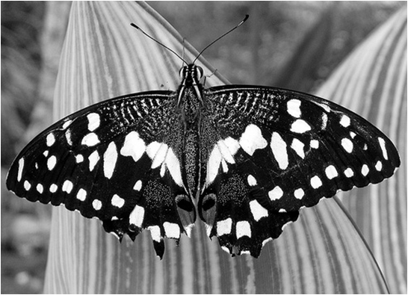
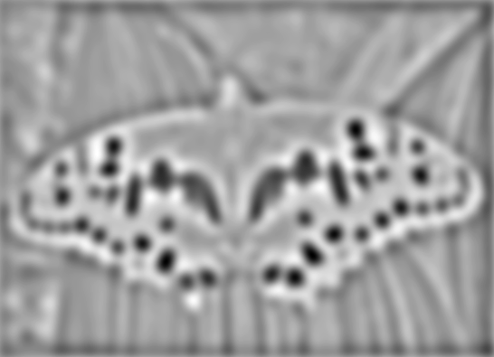

Perceptron: template matching interpretation
We can think about the optimized weights as an image sized template in zero mean cross correlation (ZMCC) algorithm.
We get a strong positive response when the template matches the image area.
minima
*
=
maximum

Slide 45
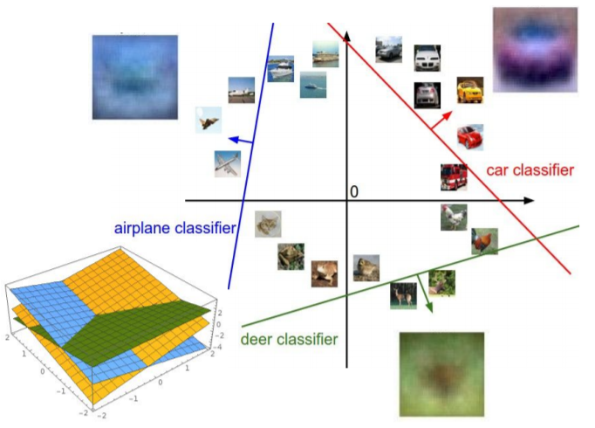
Perceptron: template matching interpretation
In our case the template is the size of the image.
We can see examples of templates for different groups- the optimized template can bee thought of as the mean of the class.

Slide 46
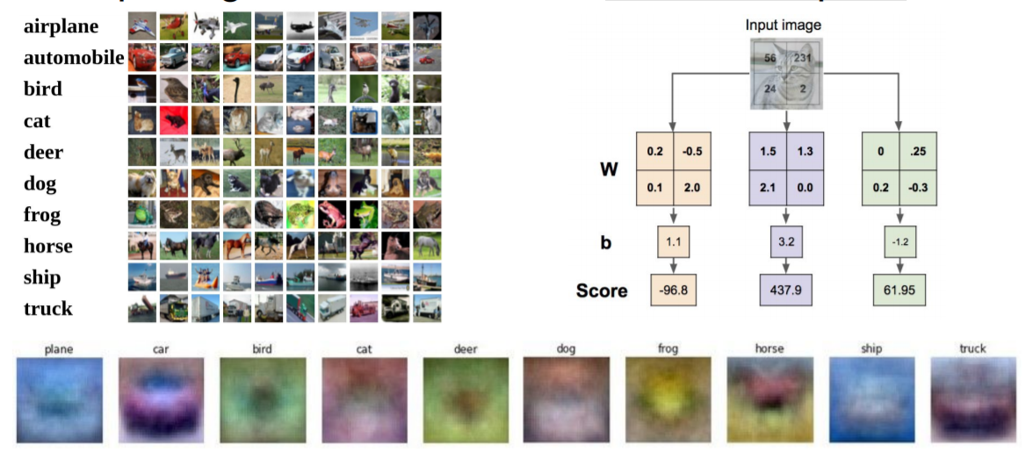
Perceptron: template matching interpretation

Slide 47
contents
The classification problem- again
NN history
Perceptron
Hyperplanes
Activation
Dense layer
Multi-layer perceptron (MLP)
Optimization
Softmax + cross entropy + loss
Gradient descent
Basic data preprocessing
Data normalization
Train, validation and test splits

Slide 48
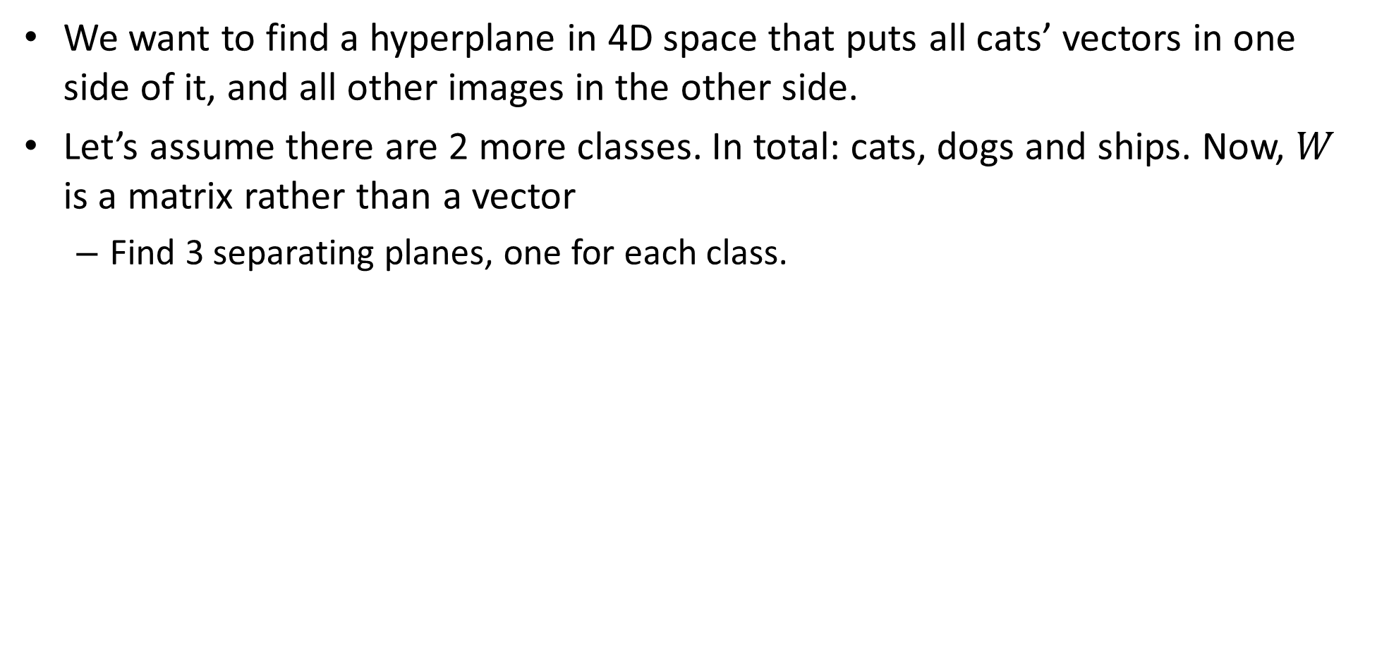
Hyperplanes and image classification
We want to find a hyperplane in 4D space that puts all cats’ vectors in one side of it, and all other images in the other side.
Let’s assume there are 2 more classes. In total: cats, dogs and ships. Now, $W$ is a matrix rather than a vector
Find 3 separating planes, one for each class.

Slide 49
Dense layer
This is the first NN layer we encounter- all inputs are going through multiple perceptrons at the same time.
This layer is called dense layer or fully-connected layer.

Slide 50
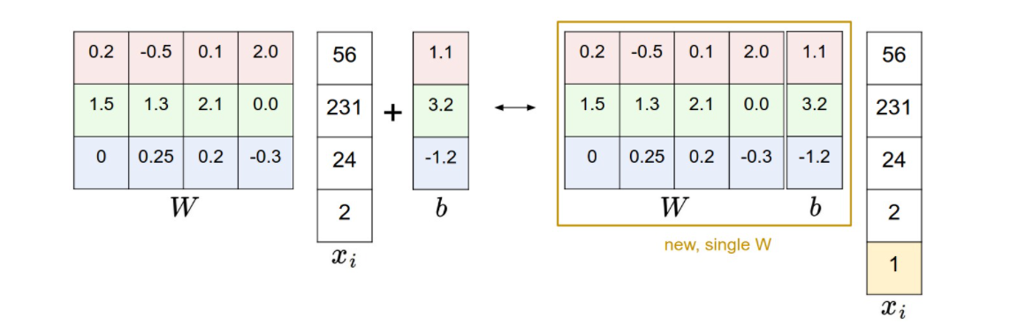
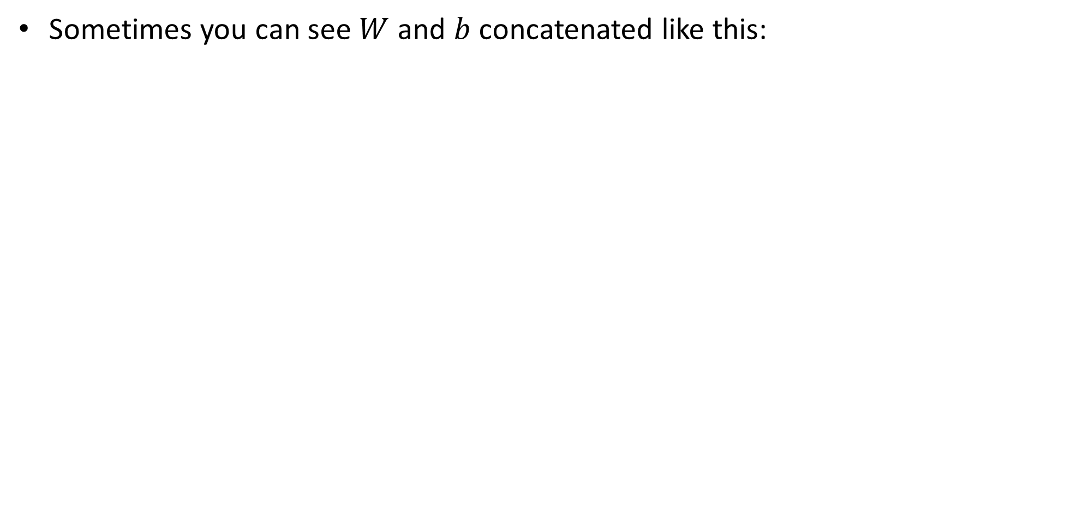
Dense layer
Sometimes you can see $W$ and $b$ concatenated like this:

Slide 51
contents
The classification problem- again
NN history
Perceptron
Hyperplanes
Activation
Dense layer
Multi-layer perceptron (MLP)
Optimization
Softmax + cross entropy + loss
Gradient descent
Basic data preprocessing
Data normalization
Train, validation and test splits

Slide 52
Hyperplane classification is not enough
Not all datasets can be linearly separable.
Try classify as the positive +1 class using a perceptron.

Slide 53
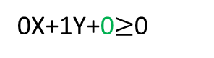


Hyperplane classification is not enough
multi-layer perceptron (MLP), or in a more common name- neural network, is a better approach to try to handle this data.
0
X
1
1
0
1X+0Y+0$≥$0
-1.5
0
1$\left(X≥0\right)+1\left(Y≥0\right)−1.5≥0$
0
Y
1
1
0X+1Y+0$≥$0

Slide 54


Feature transformation
Another example without perceptrons:
We can build “new” features from the data and then classify it!

Slide 55

Hyperplane classification is not enough
We can build a transformation function from our feature data $[x,y]$ to a new linearly separable dataset:
$$T([x,y])→[x,y,x^{2}+y^{2}]$$
Now we can separate the dataset with the plane $Z=4$ for example.

Slide 56

Feature transformation
By using multiple layers with varying number of neurons in each we can try and transform any input data to some space where it can be linearly separable.
https://www.youtube.com/watch?v=Uf3wnBNXV4k
The activation function is really important for the transformation.

Slide 57


Activation functions
Here are some more activation functions.
The most used is the rectified linear unit (ReLU) function:
$f\left(x\right)=\max\left(x,0\right)=\left\{\begin{aligned}0, x<0 \\ &x, x≥0\end{aligned}\right.$
Other known activation functions: sigmoid, tanh, leaky ReLU.

Slide 58

Multi-layer NN
What happens if we remove the non-linear activation?
$$f=W_{2}\max\left(0,W_{1}x\right)$$

Slide 59

Multi-layer NN
What happens if we remove the non-linear activation?
$$f=W_{2}\max\left(0,W_{1}x\right)→W_{2}W_{1}x=\tilde{W}x$$
We’ve gotten a linear separator again… not good.
Remember the activation function!

Slide 60




Multi-layer NN
2-layer NN example: Learned 100 different templates in the first layer and input them into a second layer for final classification.
10D results for final classification
3072D input vector
(10 x [100+1] matrix)
(100 x [3072+1] matrix)
100D intermediate vector
Don’t forget the bias!

Slide 61

Multi-layer NN
Total number of weights to learn:
[3,072+1] x 100 + [100+1] x 10 = 308,310

Slide 62

Neural network architecture
Computation graph for a 2-layer neural network.
Only count layers with tunable weights (so don’t count the input layer).
Each layer is built from perceptrons: weights + bias + activation function.
Our data (not weights)
One Neuron/ perceptron

Slide 63

Neural network architecture
Deep networks typically have many layers and potentially millions of parameters.
Fully connected layer is a layer in which all inputs are multiplied for each perceptron with different weights. (this is what we saw until now).

Slide 64

Neural network architecture
Example of a deep NN: Inception network (GoogLeNet, Szegedy et al, 2015)
22 layers

Slide 65
contents
The classification problem- again
NN history
Perceptron
Hyperplanes
Activation
Dense layer
Multi-layer perceptron (MLP)
Optimization
Softmax + cross entropy + loss
Gradient descent
Basic data preprocessing
Data normalization
Train, validation and test splits

Slide 66
Optimizing the weights
We have this results for each possible label.
which is the best result currently? Which should be the best result?

Slide 67

Softmax layer
The softmax layer normalizes all the results so that you get a percentage of correctness for each label and in use with the classification problem.
The softmax is usually added as the last layer in a NN training to normalize the results instead of an activation function.

Slide 68

Cross entropy loss function
Only during training time, we need to define an error of the given probabilities and the correct (wanted) probabilities.
A known loss function for the classification problem is called cross entropy loss.

Slide 69


Cross entropy loss + softmax
Cross entropy is a way to measure “distance” between the wanted distribution of results $p$ and given distribution of results $q$:
Notes:
\\
L_i = -\sum_{j\in labels} p(j)\, \log q(j)
\\\\
\xrightarrow{
\left\{\begin{matrix}
p(j)=1 \, \text{if } j=y_i \text{ (right label)} \\
p(j)=0\,\, \forall \,\,j\neq y_i
\end{matrix}\right.
}
\\
L_i = -\log q(y_i)
\\\\
\xrightarrow{\text{plug in with softmax classifier}}
\\
L_i = -\log (\frac{e^{s_{y_i}} }{\sum_{j} e^{s_j}})

Slide 70

Total loss
This $L_{i}$ is the loss of a single given input image $x_{i}$.
Let’s say we have all possible images in the world, so the total loss will be:
$$L=\frac{1}{N}\sum_{i=1}^{N}{L_{i}}$$
A mean of all possible losses, where $N$ is number of images.
We want to find the best $W$ that minimizes $L$.
How do we do this?

Slide 71

Total loss
This $L_{i}$ is the loss of a single given input image $x_{i}$.
Let’s say we have all possible images in the world, so the total loss will be:
$$L=\frac{1}{N}\sum_{i=1}^{N}{L_{i}}$$
A mean of all possible losses, where $N$ is number of images.
We want to find the best $W$ that minimizes $L$.
How do we do this?
Derive over $W$: $∇_{W}L$

Slide 72
contents
The classification problem- again
NN history
Perceptron
Hyperplanes
Activation
Dense layer
Multi-layer perceptron (MLP)
Optimization
Softmax + cross entropy + loss
Gradient descent
Basic data preprocessing
Data normalization
Train, validation and test splits

Slide 73

Finding the best W
How do we do this?
Derive over $W$: $∇_{W}L$
Problems:
We don’t have all images, and even if we do, it will take forever…
No one said $L$ is a convex function.
It’s sometimes hard to compute the analytic derivative of the function $L$ in order to naively find all extremum points.
An approximate solution to find best $W$is called mini-batch gradient descent.

Slide 74

Finding the best W
How do we do this?
Derive over $W$: $∇_{W}L$
Problems:
We don’t have all images, and even if we do, it will take forever…
No one said $L$ is a convex function.
It’s sometimes hard to compute the analytic derivative of the function $L$ to naively find all extremum points.
An approximate solution to find best $W$is called mini-batch gradient descent.

Slide 75


What is a gradient?
describes the direction and magnitude of the fastest increase around a point $x$.
Example: gradient of a function of 2 variables:
Notes:
\frac{\partial f(\vec{x})}{\partial \vec{x}} =
\bigg [
\frac{\partial f(\vec{x})}{\partial x}, \frac{\partial f(\vec{x})}{\partial y}
\bigg]

Slide 76

Gradient descent
An iterative algorithm for finding local minima of functions.
starts at a random point and moves step-by-step in the direction and proportional magnitude of the negative of the gradient of the point he is currently in:
“proportional magnitude” == step size $η.$
In “proper use” this algorithm converges to a local minimum which is depended on the starting point.

Slide 77


Gradient descent
Plug in our relevant math symbols:
We will write it like so for brevity:
Notes:
w_i = w_{i-1}- \eta \nabla_w \frac{1}{N}\sum_{j=1}^NL_j(w)
w_i = w_{i-1}- \eta \nabla_w \mathcal{L}

Slide 78


Gradient descent- step size
Also known as learning rate.
This is known as a hyperparameter: an unknown variable that is configured by the user (unlike the weights $W$which the system “learns”).
The learning rate can change over time- after several steps you can make the step size smaller for finer results (this is known as learning rate decay).

Slide 79

Examples of learning rates

Slide 80
Gradient descent- local minima
An iterative algorithm for finding local minima of functions.
we can initiate this procedure several times from several random staring points and take the minimum of all output minimum points- this way we can get a better result.

Slide 81

Finding the best W
How do we do this?
Derive over $W$: $∇_{W}L$
Problems:
We don’t have all images, and even if we do, it will take forever…
No one said $L$ is a convex function.
It’s sometimes hard to compute the analytic derivative of the function $L$ for all possible $x$ to naively find all extremum points.
An approximate solution to find best $W$is called mini-batch gradient descent.

Slide 82

Mini-batch
In mini-batch gradient descent we take only a small subset of images and compute their average loss:
$$\tilde{L}=\frac{1}{\tilde{N}}\sum_{i=1}^{\tilde{N}}{L_{i}}$$
A mean of the subset losses, where $\tilde{N}$ is the size of images subset.
This approximation of the loss function is faster to compute but less accurate.

Slide 83

Mini-batch gradient descent
Combining the two methods is called Mini-batch gradient descent.
Almost always mis-called stochastic gradient descent (SGD)…
This is the name only if the batch size is 1.

Slide 84

Loss function animation

Slide 85

Loss noise

Slide 86
contents
The classification problem- again
NN history
Perceptron
Hyperplanes
Activation
Dense layer
Multi-layer perceptron (MLP)
Optimization
Softmax + cross entropy + loss
Gradient descent
Basic data preprocessing
Data normalization
Train, validation and test splits

Slide 87


Data normalization
Assuming 2D input data with different scales ($x_{1}∈\left[0,1\right],$ $x_{2}∈\left[0,1000\right]$)
The weights needed to make $x_{1}$ significant as $x_{2}$ are much larger, and hence make the loss function ellipsoid in one direction.
This will cause the gradient descent method to converge in more steps than if the two axis where at the same scale.

Slide 88

Data normalization
In order to overcome this, we shall normalize the data before the entrance to the NN:
$$μ=\frac{1}{m}\sum_{i=0}^{m}{x_{i}},σ^{2}=\frac{1}{m−1}\sum_{i=0}^{m}{{{(x}_{i}−μ)}^{2}} \\ \tilde{x_{i}}=\frac{x_{i}−μ}{σ^{2}}$$
This should be done for each dimension of the input vector independently.
The test data should be normalized with the same variables found in the train data.
This is a common practice to do even if the data are at the same scale for all dimensions since the default hyperparameters for all NN are based on such normalized data.

Slide 89

Testing the results
NN frameworks are build on learning from examples, so the data is important.
Usually, we split the data to 3 different datasets:
Train: to train the weights.
Validation: test the resulted NN with specific architecture on unseen data.
Test: compare different types of NN architectures/ change in hyperparameters which are not learned.
If we don’t have a validation dataset, we will eventually change the architecture/ hyperparameters so they will fit the test data- basically learning on the unseen dataset- not good.

Slide 90
Fully connected colab

